Slide 1
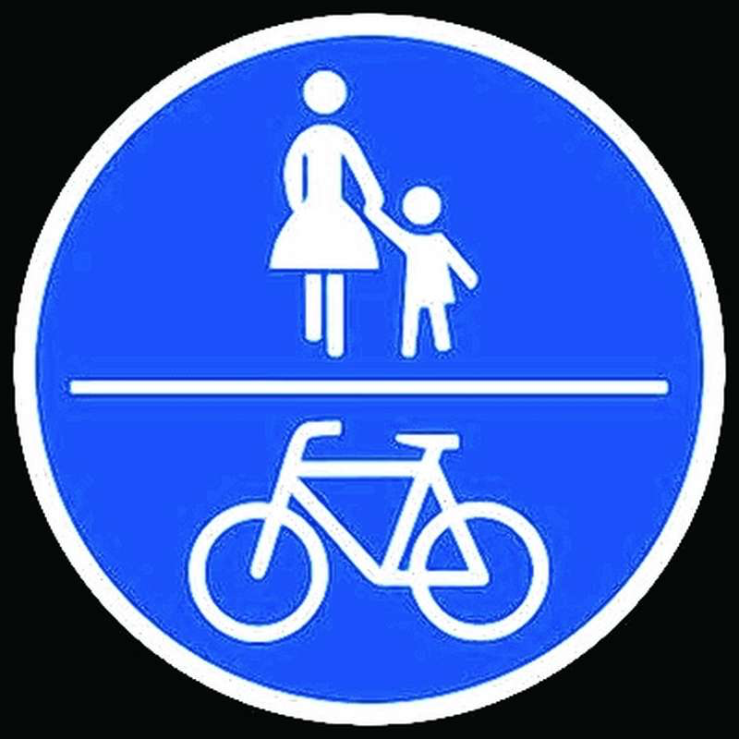
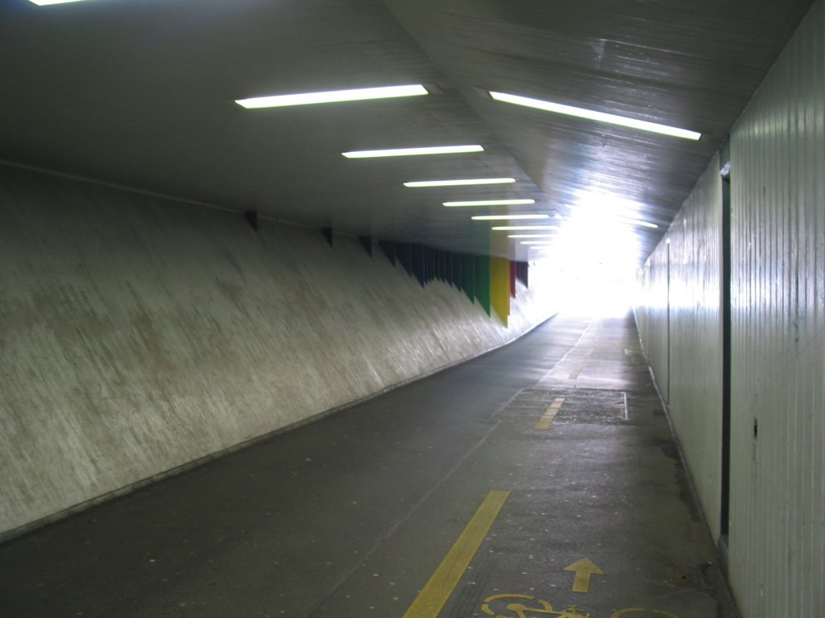
Modelling the interaction of pedestrians and bikers
We love cycling
Every day experience
Social Force Model
Capacity and Security
Bicycle bell
Bikeswarms
Sandro Giacomuzzi - Hannes Heller – Manuel Holzer

Slide 2
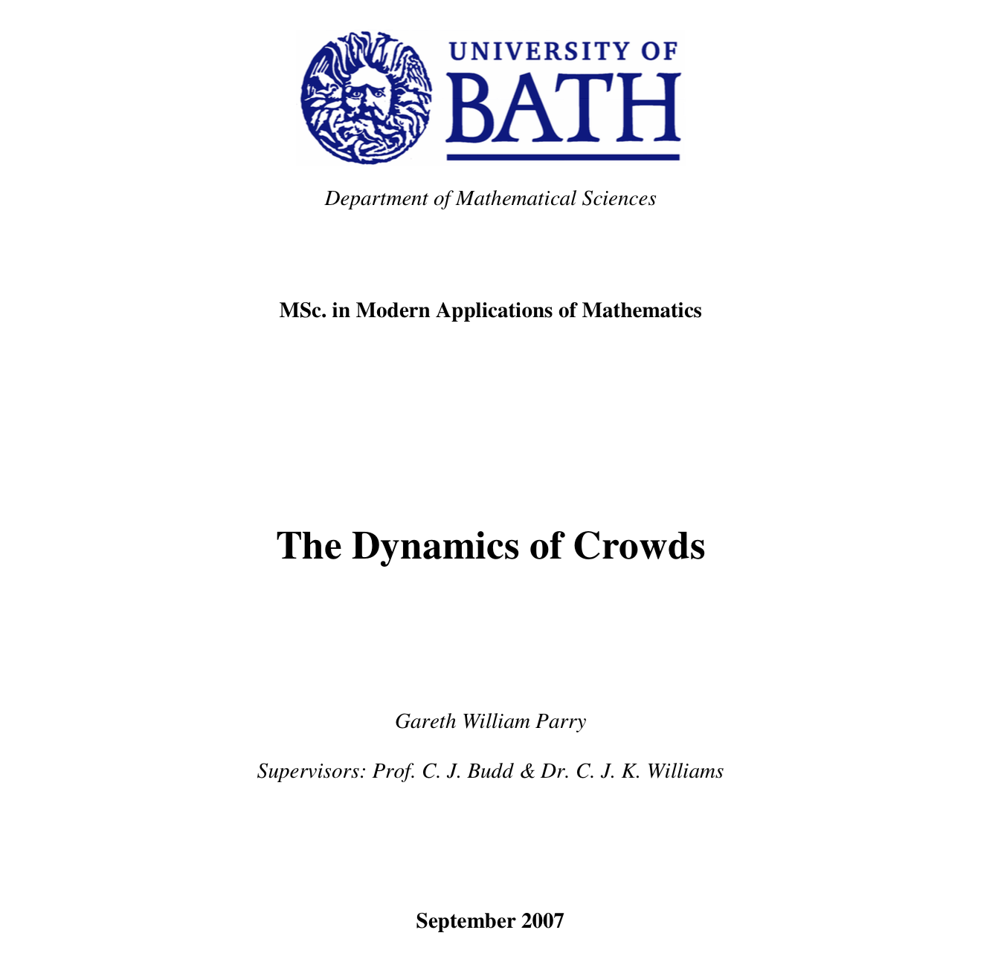

Slide 3


